Slide 1
WEB3, Session 4
Components

Slide 2
Routing
Typically, an app is in different states - corresponding to different screens/tabs/etc.
Changing between the different states is sometimes called routing in web apps.
Poor Man's Routing: <lobby-view v-if="gameState.mode=='no game'" .../> <waiting-view v-if="gameState.mode=='waiting'" .../> <game-view v-if="gameState.mode=='playing'" .../>

Slide 3
Problems with Poor Man's Routing
It gets big and difficult to maintain in large apps
It doesn't leave a trace in the history
It breaks the back button
Note: sometimes the back button just have to be broken

Slide 4
vue-router
Same basic idea as React routing (WEB 2)
Each route is a path
A path is bound to a component
You can transfer path and query parameters
Advice: try to make sure the URLs are usable directly in the browser

Slide 5
Example
const routes = [
{ path: '/', component: LobbyView },
{ path: '/waiting/:gameNumber', component: WaitingView },
{ path: '/playing/:gameNumber', component: GameView}
]
const router = VueRouter.createRouter({
history: VueRouter.createWebHistory(),
routes
})

Slide 6
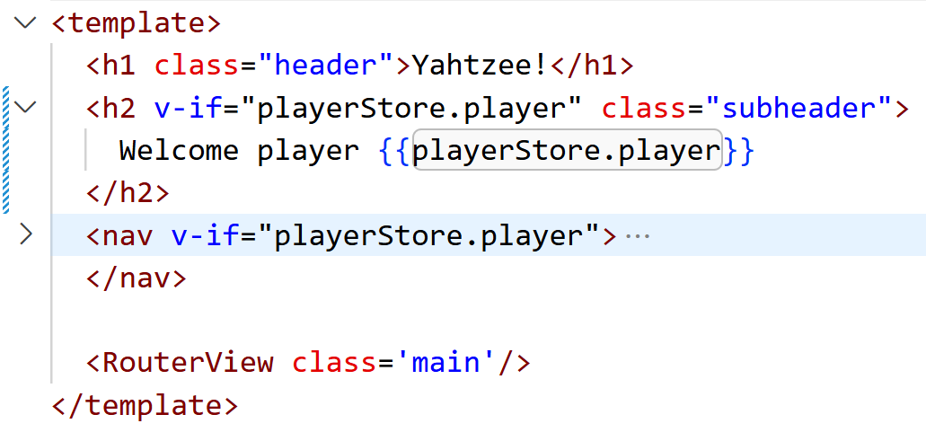
Poor Man's Routing

Slide 7
Navigating
async function join(gameNumber: number) {
const game = await api.joinGame(gameNumber)
model.startGame('O', game)
router.push(`/playing/${game.gameNumber}?player=O`)
}
// Or a direct link:
<RouterLink to="/playing/5?player=O">Go to Game</RouterLink>

Slide 8
Path and query parameters
const route = useRoute()
const gameNumber = Number.parseInt(route.params.gameNumber as string)
const player = route.query.player as Player

Slide 9
A Component
A visual unit that we can use as normal HTML tags
A component has
A view model
Underlying data
Properties
Events (“emits”)
template (Vue HTML template language)
style (CSS)
declaration of sub-components

Slide 10
State management
Local State Management
The state is mostly defined in the components
State is transferred to child components using properties (props)
State is transferred to parent components using listeners (emits)
Global State Management
The state is defined in a single place (single source of truth)
This can be a global variable (or singleton pattern, if you prefer)
The variable need to be reactive
Alternatively: Use a library

Slide 11
Props
A property that we can use like
<component :prop=“user”/>
Defined in the viewmodel
Typed or untyped
Optional or required

Slide 12
Emits
Events that you can use like
<component @event=“method”/>
Declared in the view model
Either
Parameterless
or with a parameter and a check for validity

Slide 13
Defining props and emits in <setup script>
defineProps<{
personData: Data[]
}>()
let emit = defineEmits({
hire(_: number) {
return true
}
})

Slide 14
Using emits in <setup script>
function hire(id: number) {
emit('hire', id)
}

Slide 15
Using props in the component template
<tr v-for='p in personData'>
…
</tr>

Slide 16
Using props and emits in the parent component
/* In <setup script>:
function hire(id: number) {...}
*/
<person-view
:person-data="model.personData()"
@hire="hire">
</person-view>

Slide 17
Component Hierarchy

Slide 18
Avoiding prop drilling
Prop drilling
(From React)
When props are forwarded down through the hierarchy to end up at a very low level.
Provide
A component high in the hierarchy can provide one or more objects.
Inject
A component lower in the hierarchy can declare that it wants the property injected.
(renaming, default value)

Slide 19
provide and inject
// In a parent component:
provide('game', ref(props.game))
// In a child component:
const game = inject('game')

Slide 20
Slots
Usually, HTML tags surround other content
In vue.js components, there is a special tag, <slot>, that stands for the surrounded content.
When rendered, the <slot> tag will be replaced with the surrounded content.
You may know this from HTML Web Components
Note: <template> and <slot> tags get replaced in the vue.js rendering, so they will not appear in the DOM. You can’t mix vue.js with HTML Web Components.

Slide 21
A Bit of a Hack (old yahtzee-graphql/src/App.vue)

Slide 22
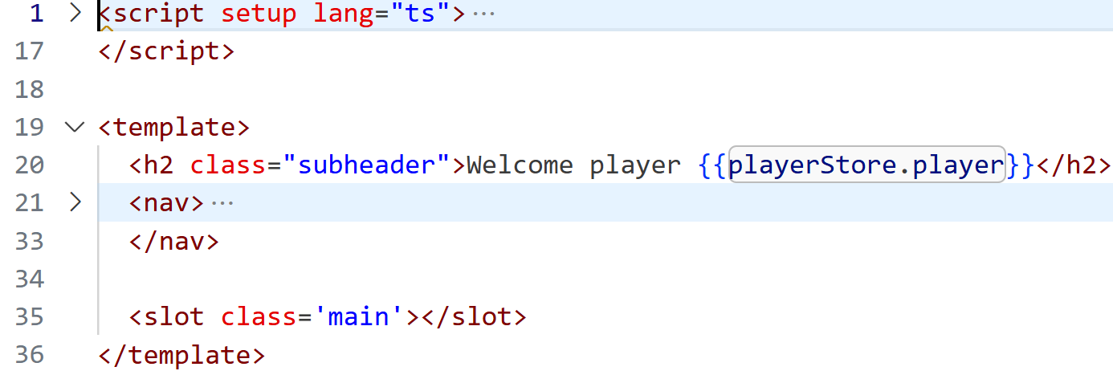
A wrapper for the relevant pages (src/components/Page.vue)

Slide 23
Wrapping the page
<template>
<Page v-if="playerStore.player">
<main>
Number of players:
<input min="1" type="number" v-model="number_of_players"/>
<button @click="new_game(playerStore.player)">New Game</button>
</main>
</Page>
</template>

Slide 24
Advanced Slots
Named slots – allows more slots in the component
Naming a slot outlet: <slot name='header'></slot>
Content for that outlet: <template v-slot:'header'>…</template>
Scoped slots
Passing properties to slot content: <slot :count='7'></slot>
Receiving properties in the content: <MyComponent v-slot='{count}'>
Named scoped slots
<slot name='header' :count='7'></slot>
<template #header='{count}'>…</template>

Slide 25
Example: Grid
<template>
<table id = 'board'>
<tr v-for='row in tiles()'>
<td name='tile' v-for='tile in row' class="cell">
<slot name='tile' v-bind='tile'></slot>
</td>
</tr>
</table>
</template>

Slide 26
Using the Grid component
04 Components/tic-tac-toe - routing/components
Grid.vue
ActiveGame.vue
FinishedGame.vue

Slide 27
Component tree

Slide 28
Global State Management
Global state: const gameState = ref({mode: 'no game'} as GameState)
You can either
export the ref and import it in all components
create an object that uses the variable and export that
use the singleton pattern and have the variable as private in a class
Alternatively, use a library
We'll be looking at Pinia

Slide 29
Pinia
Sometimes touted as the Vue.js equivalent to Redux
A tool to create a global, reactive state
Two API versions
Option stores: Like the Vue.js options API
Setup stores: Like the Vue.js composition API
Allows for better tooling than the simple reactive object
Safer, if you want to use Vue.js for server-side rendering

Slide 30
Pinia option store
export const store = defineStore('model', {
state() {return {games: [], gameState: {mode: 'no game'}},
getters: {
player: () => this.gameState.value.player
},
actions: {
endGame() {
this.gameState.value = {mode: 'no game'}
}
}
})

Slide 31
Pinia Composition
export const store = defineStore('model', () => {
const games = ref([] as Game[])
const gameState = ref({mode: 'no game'})
const player = computed(() => gameState.value.player)
function endGame() {
gameState.value = {mode: 'no game'}
}
return {games, gameState, player, endGame}
})

Slide 32
Example
tic-tac-toe - global state - the global variable solution
tic-tac-toe - pinia - the Pinia solution

Slide 33
Testing
tic-tac-toe – routing/__test__/lobby.test.ts

